Slide 1

School of Computing Science and Engineering
Subject Name: Computer Workshop Subject Code: BCS01T1004
CAT-3 Presentation
Evolution of Internet & Impact of Social Network On Human and Society
Programme Name: B.TECH(CSE)
Section: 20
Submitted by:-
Karanjit
Faisal Hussain
Shri bharadwaj
Submitted to:-
MR.SAHADAT HUSSAIN
School of COMPUTING Science AND ENGINEERING Galgotias University

Slide 2
Content:-
History of Internet
Internet Growth in India
Evolution of Internet
Evolution in types of Internet
Evolution in Speed of Internet
Internet service providers
Impact of Social Network on human & society
The good impact of Social Network
The good impact of Social Network
Key Facts and Figures
Program Name: B.Tech (CSE)

Slide 3
History of Internet
Internet in India began in 1986 and was available only to the educational and research community. General public access to the internet began on 15 August 1995, and as of 2020 there are 718.74 million active internet users that comprise 54.29% of the population.
The history of internet in India began with the launch of the Educational Research Network (ERNET) in 1986.
ERNET was initiated by the Department of Electronics (DoE), with funding from the Government of India and United Nations Development Program (UNDP), involving eight premier institutions as participating agencies—NCST Bombay, Indian Institute of Science, five Indian Institutes of Technology (Delhi, Mumbai, Kanpur, Kharagpur and Chennai), and the DoE in New Delhi.
ERNET began as a multi protocol network with both the TCP/IP and the OSI-IP protocol stacks running over the leased-line portion of the backbone.
Program Name: B.Tech (CSE)

Slide 4
Although the Internet was developed much earlier, it only became popular in households in the 1990s. The emergence of the Internet can be tracked by how many businesses and homes started changing the way they worked and started connecting their laptops and other devices to the Internet. However, the concept of hypertext transfer protocol (HTTP) as we know it today, was created only during this time. This meant that people could access the same web pages on their devices now and share information. The history of internet in India began with the launch of the Educational Research Network (ERNET) in 1986. The network was made available only to educational and research communities. In the same year, 64 kbit/s Internet gateway link was commissioned from NCST Mumbai to UUNet in Virginia, United States. It all happened in last two decades and no one would have really expected that internet will change the life in such a short span of time. Here is the list of events to show the history of internet growth in India. The internet came in the year 1960 with the creation of the first working model called ARPANET (Advanced Research Projects Agency). It allowed multiple computers to work on a single network that was their biggest achievement at that time. ARPANET use packet switching to communicate multiple computer systems under a single network. In October 1969, using ARPANET first message was transferred from one computer to another. After that technology continues to grow.
Internet Growth in India
Program Name: B.Tech (CSE)

Slide 5
Before 1995 internet was only used by military and research purposes without access to public. On the independence day of 1995, internet was offered to public in six cities through telephone connection. People should pay at least for 100 hours with the per hour payment of Rs 35.
The first publicly available internet service in India was launched by state-owned Videsh Sanchar Nigam Limited (VSNL) on 15 August 1995. At the time, VSNL had a monopoly over international communications in the country and private enterprise was not permitted in the sector. The internet service, known as the Gateway Internet Access Service (GIAS), provided a speed of 9.6 kbit/s speed and was priced at ₹5,200 for 250 hours for individuals, ₹16,200 for institutional dial-up SLIP/PPP accounts, and higher for leased line services
Program Name: B.Tech (CSE)

Slide 6
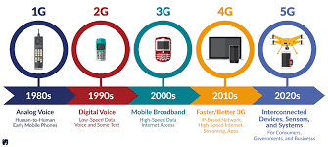
1996 – some news publishers opened websites for their own publications. 1997 – Telecom Regulatory Authority of India (TRAI) was formed to provide transparent environment in telecommunication. 1998 – Saber Bhatia sold his Hotmail to Microsoft for $400 million. Also the private sector companies started offering internet services to public. 1999 – Lot of internet companies were opened leading to dot com bubble.
Program Name: B.Tech (CSE)

Slide 7
2000 – Indian parliament passed information technology act. Also popular companies like Yahoo! started their Indian branches. 2001 – Indian railway started the online booking through internet website. 2002 – Internet telecom companies got approval from government for establishing under ocean network cables. 2003 – First Indian online flight booking was started. 2004 – BSNL started broadband services and broadband policy was release by Indian telecom ministry. 2005 – Google launched its social networking site Orkut. 2006 – Facebook started services to Indian users. 2008 – Apple’s iPhone was introduced in India. 2010 – 3G spectrum was offered on auction. 2011 – Government introduced the service to switch internet connection without changing the phone number. 2012 – Number of worldwide internet users reached 250 crores (2.5 billion). 2012– Introduction to 4G in form of Dongle and Modems through TD-LTE by Airtel. 2013 – There were 161 companies offering internet services during mid of the year. 2014 – India became the third largest internet users community with around 20 crore users. 2015 – Facebook started internet.org scheme partnered with Reliance Communications. Later the internet.org scheme was banned by Telecom Regulatory Authority of India (TRAI). 2016 – TRAI decided to continue net neutrality by rejecting the proposal of Charing different amount for accessing different sites and services. 5 Sep 2016:- Finally India got Introduced to 4G in the form of jio and then after it continues………….
Program Name: B.Tech (CSE)

Slide 8
Evolution of Internet:
In 2004, the government formulated its broadband policy which defined broadband as "an always-on Internet connection with download speed of 256 kbit/s or above. From 2005 onward, the growth of the broadband sector in the country accelerated, but remained below the growth estimates of the government and related agencies due to resource issues in last-mile access which were predominantly wired-line technologies.
This bottleneck was removed in 2010 when the government auctioned 3G spectrum followed by an equally high-profile auction of 4G spectrum that set the scene for a competitive and invigorated wireless broadband market.
Today, internet access in India is provided by both public and private companies using a variety of technologies and media including dial-up (PSTN), xDSL, coaxial cable, Ethernet, FTTH, ISDN, HSDPA (3G), Wi-Fi, WiMAX, etc. at a wide range of speeds and costs.
Program Name: B.Tech (CSE)

Slide 9
Evolution in types of Internet:
Wireless Internet
The following frequencies are used to provide wireless internet services in India:^{[14]}
2G : GSM 900 MHz, GSM 1800 MHz
3G : WCDMA UMTS 2100 MHz, 900 MHz
4G : TD-LTE 2300 MHz, 2500 MHz, FD-LTE 2100 MHz, 1800 MHz, 900 MHz, 850 MHz
CDMA : 800 MHz (for 1x voice and data & EVDO Rev A, Rev B, Rev B Phase II data)
Wired internet
Fixed-line or wired internet technologies used in India include
Digital subscriber line, (DSL),
Dial-up Internet access,
Ethernet
Local area network (LAN),
Cable modem,
Fibre to the home,
Leased line.
Program Name: B.Tech (CSE)

Slide 10
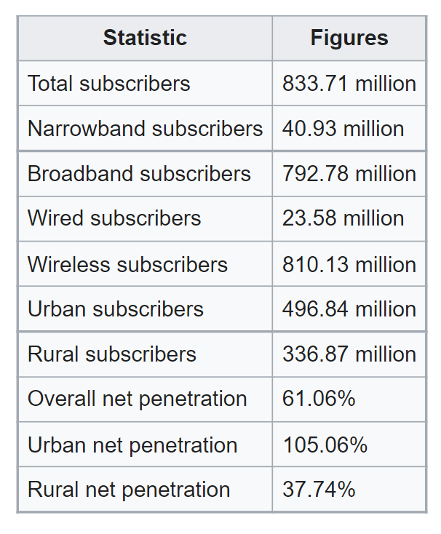
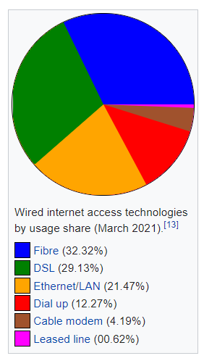
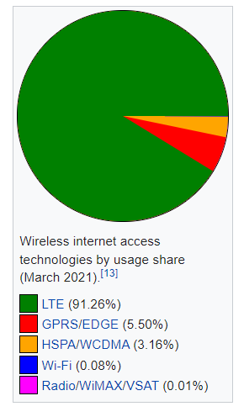
Here are some research statics on uses of internet:
Program Name: B.Tech (CSE)

Slide 11
Evolution in Speed of Internet:
The broadband policy formulated by government in 2004 which defined broadband as "an always-on Internet connection with download speed of 256 kbit/s or above." was amended in July 2013 defining broadband as a "data connection that supports interactive services, including internet access, capable of a minimum download speed of 256 kbps to an individual subscriber." The minimum download speed was officially raised from 256 kbit/s to 512 kbit/s in August 2014.
On 31 August 2021, TRAI recommended raising the minimum broadband speed to 2 Mbps.
The worldwide broadband speed league 2021 ranked India 80th out of 224 countries with a mean download speed of 22.53 Mbps.
Globally, India was ranked 89th out of 149 countries/regions by average internet connection speed and 97th by average peak connection speed.
According to the March 2021 Speed test Global Index, published by Speedtest.net, India was ranked 66th out of 177 countries by average fixed broadband speed and 86th out of 140 countries by average mobile internet speed.
The average fixed broadband download speed in India is 56.10 Mbit/s and the average fixed broadband upload speed is 53.68 Mbit/s. Speed test recorded the average download speed on mobile connections in India as 12.15 Mbit/s and average upload speed of 4.80 Mbit/s.
Program Name: B.Tech (CSE)

Slide 12
Key Facts and Figures
In 2019, it is estimated that there will be around 2.77 billion social network users around the globe.
According to a report by we are social, a leading marketing and communications services to organizations in the United Kingdom, the number of people using the top social media platform in each country has increased by almost 1 million new users every day during the past 12 months.
The global number of people using social media has grown by 13 percent in the past 12 months, with Central and Southern Asia recording the fastest gains.
Facebook is the most preferred social media platform. With more than 2000 million Facebook user world over, if a country is constituted with them, it would be the world’s third largest, behind China and India.
The other popular social media platforms are You Tube, Instagram, Twitter, Reddit, WhatsApp etc.
Program Name: B.Tech (CSE)

Slide 13
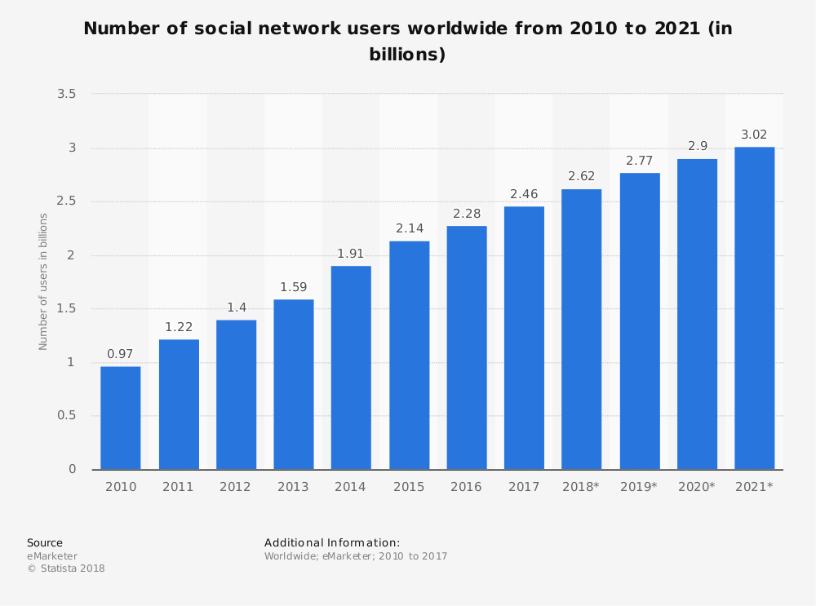
Program Name: B.Tech (CSE)

Slide 14
According to the 2017 official report published by Facebook, on average there were 1.40 billion Daily active users of Facebook for December 2017, an increase of 14% year-over-year.
According to the same source, on average there were 2.13 billion Monthly active users of Facebook as of 31 December 2017, an increase of 14% year-over-year.
According to forecasts from media analyst firm BIA/Kelsey, U.S. social media advertisement revenues are expected to grow to USD 24.2 billion in 2021.
A researcher linked to Cambridge Analytica (CA), a political consulting firm had accessed details of 50 million Facebook users. The data was shared with Cambridge Analytica, which used online data to reach voters on social media with personalized messages and swayed 2016 US elections.
Program Name: B.Tech (CSE)

Slide 15


